Slide 1
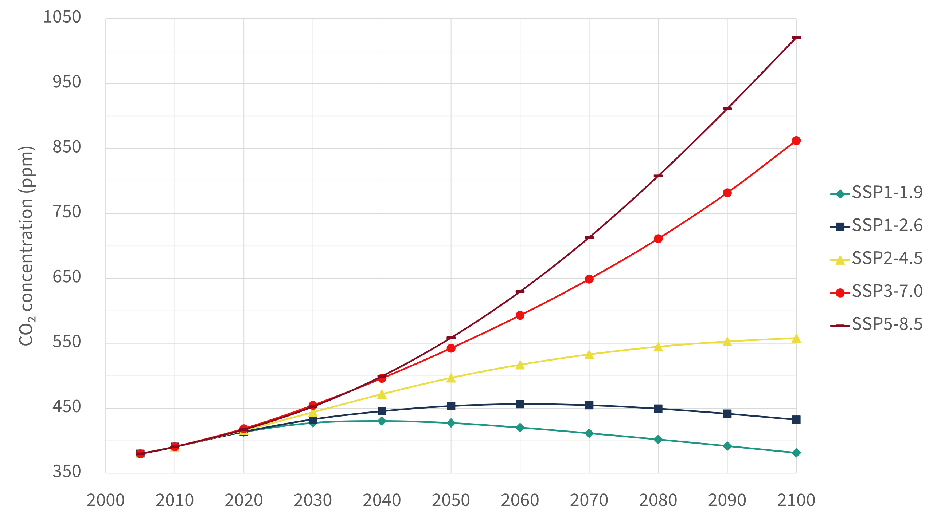
Emission scenarios and the climate sensitivity
RCP = Rep. Conc. Pathways (5th IPCC report, 2013)
SSP = New future scenarios (6th IPCC report, 2021)
https://en.wikipedia.org/wiki/Shared_Socioeconomic_Pathways

Slide 2
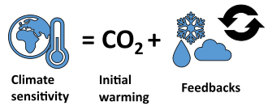
Emission scenarios and the climate sensitivity
RCP = Rep. Conc. Pathways (5th IPCC report, 2013)
SSP = New future scenarios (6th IPCC report, 2021)
https://en.wikipedia.org/wiki/Shared_Socioeconomic_Pathways

Slide 3
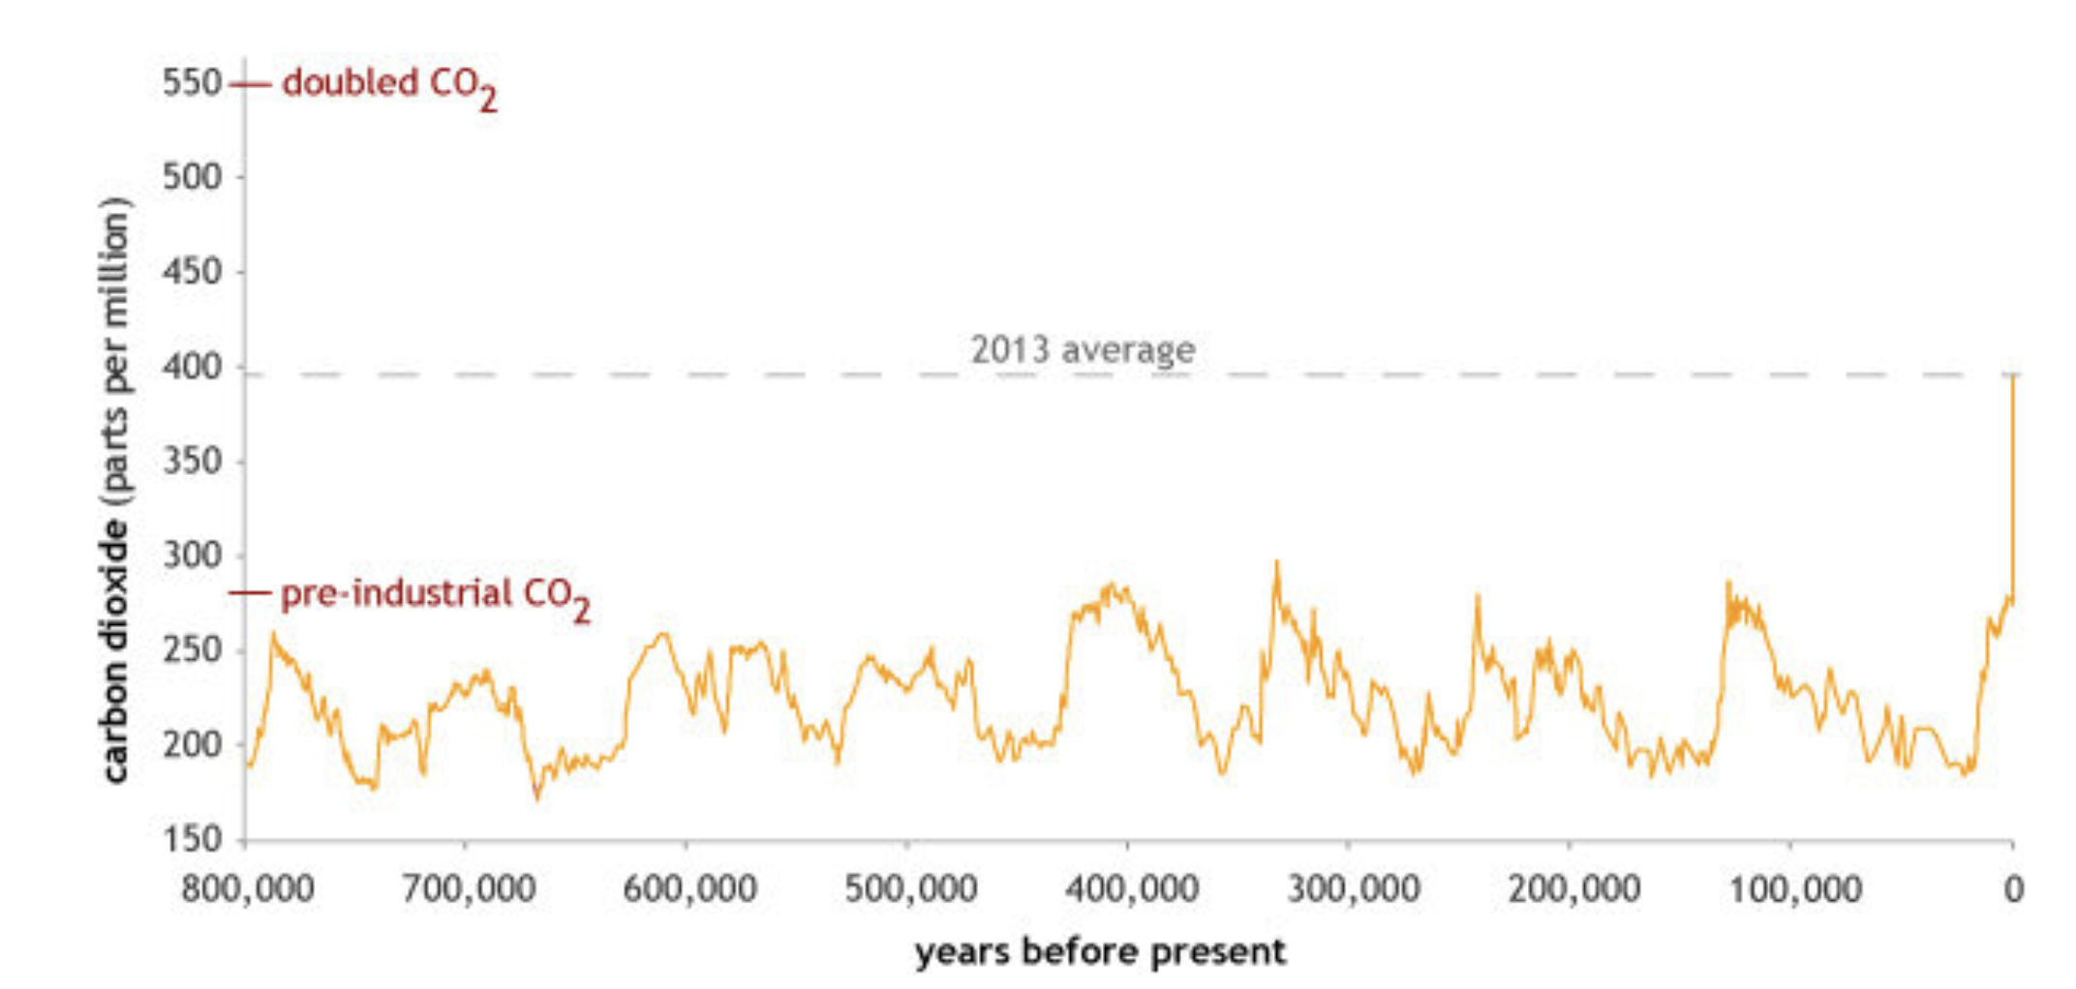
Climate Temperature Sensitivity is one way to quantify this
Doubling of CO₂ means going from 290 ppm pre-industrial, to 550 ppm.
Climate temperature sensitivity tries to quantify how many degrees warming will the world experience for that doubling.
https://www.climate.gov/news-features/climate-qa/how-much-will-earth-warm-if-carbon-dioxide-doubles-pre-industrial-levels

Slide 4
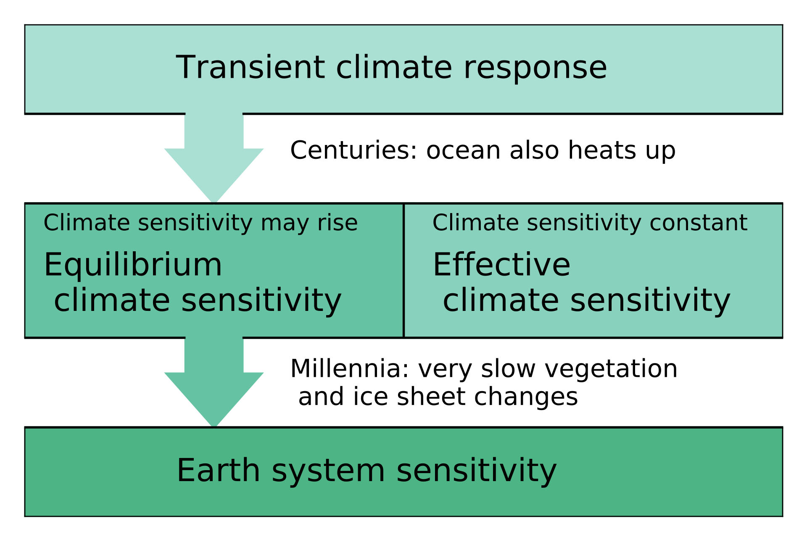
Climate Temperature Sensitivity is one way to quantify this
Doubling of CO₂ means going from 290 ppm pre-industrial, to 550 ppm.
Climate temperature sensitivity tries to quantify how many degrees warming will the world experience for that doubling.
https://www.climate.gov/news-features/climate-qa/how-much-will-earth-warm-if-carbon-dioxide-doubles-pre-industrial-levels

Slide 5
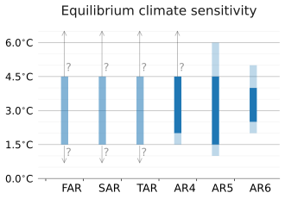
Climate Temperature Sensitivity is one way to quantify this
Doubling of CO₂ means going from 290 ppm pre-industrial, to 550 ppm.
Climate temperature sensitivity tries to quantify how many degrees warming will the world experience for that doubling.
https://www.climate.gov/news-features/climate-qa/how-much-will-earth-warm-if-carbon-dioxide-doubles-pre-industrial-levels
IPCC’s estimate back in 1990
IPCC’s estimate in 2021

Slide 6
Emission scenarios and the climate sensitivity
RCP = Rep. Conc. Pathways (5th IPCC report, 2013)
SSP = New future scenarios (6th IPCC report, 2021)
Doubling
https://en.wikipedia.org/wiki/Shared_Socioeconomic_Pathways

